Slide 1
DEVOPS
:- PULKIT DHINGRA

Slide 2
Agenda:-
Agile
DevOps Intro
Why devops ?
Devops Terminologies
Tools in Devops

Slide 3
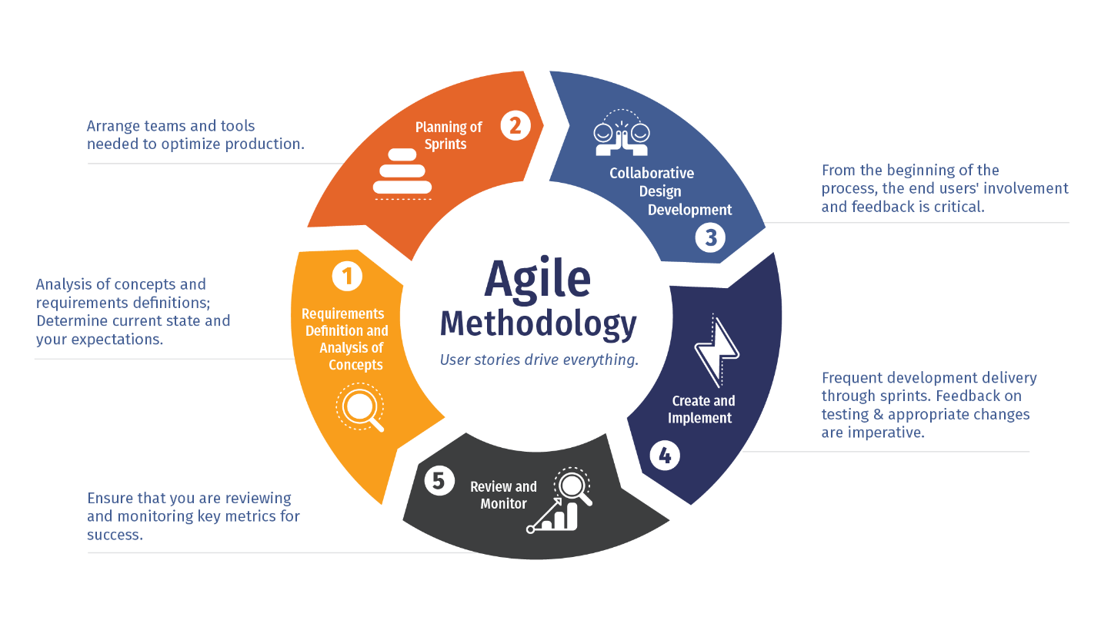
AGILE S.D.L.C
The Agile methodology is a way to manage a project by breaking it up into several phases. It involves constant collaboration with stakeholders and continuous improvement at every stage. Once the work begins, teams cycle through a process of planning, executing, and evaluating.

Slide 4
About DevOps
Wikipedia:- DevOps is a set of practices that combines software development (Dev) and IT operations (Ops). It aims to shorten the systems development life cycle and provide continuous integration and continuous delivery with high software quality. DevOps is complementary with Agile software development; several DevOps aspects came from the Agile methodology.
GITLAB :- DevOps combines development and operations to increase the efficiency, speed, and security of software development and delivery compared to traditional processes. A more nimble software development lifecycle results in a competitive advantage for businesses and their customers.

Slide 5
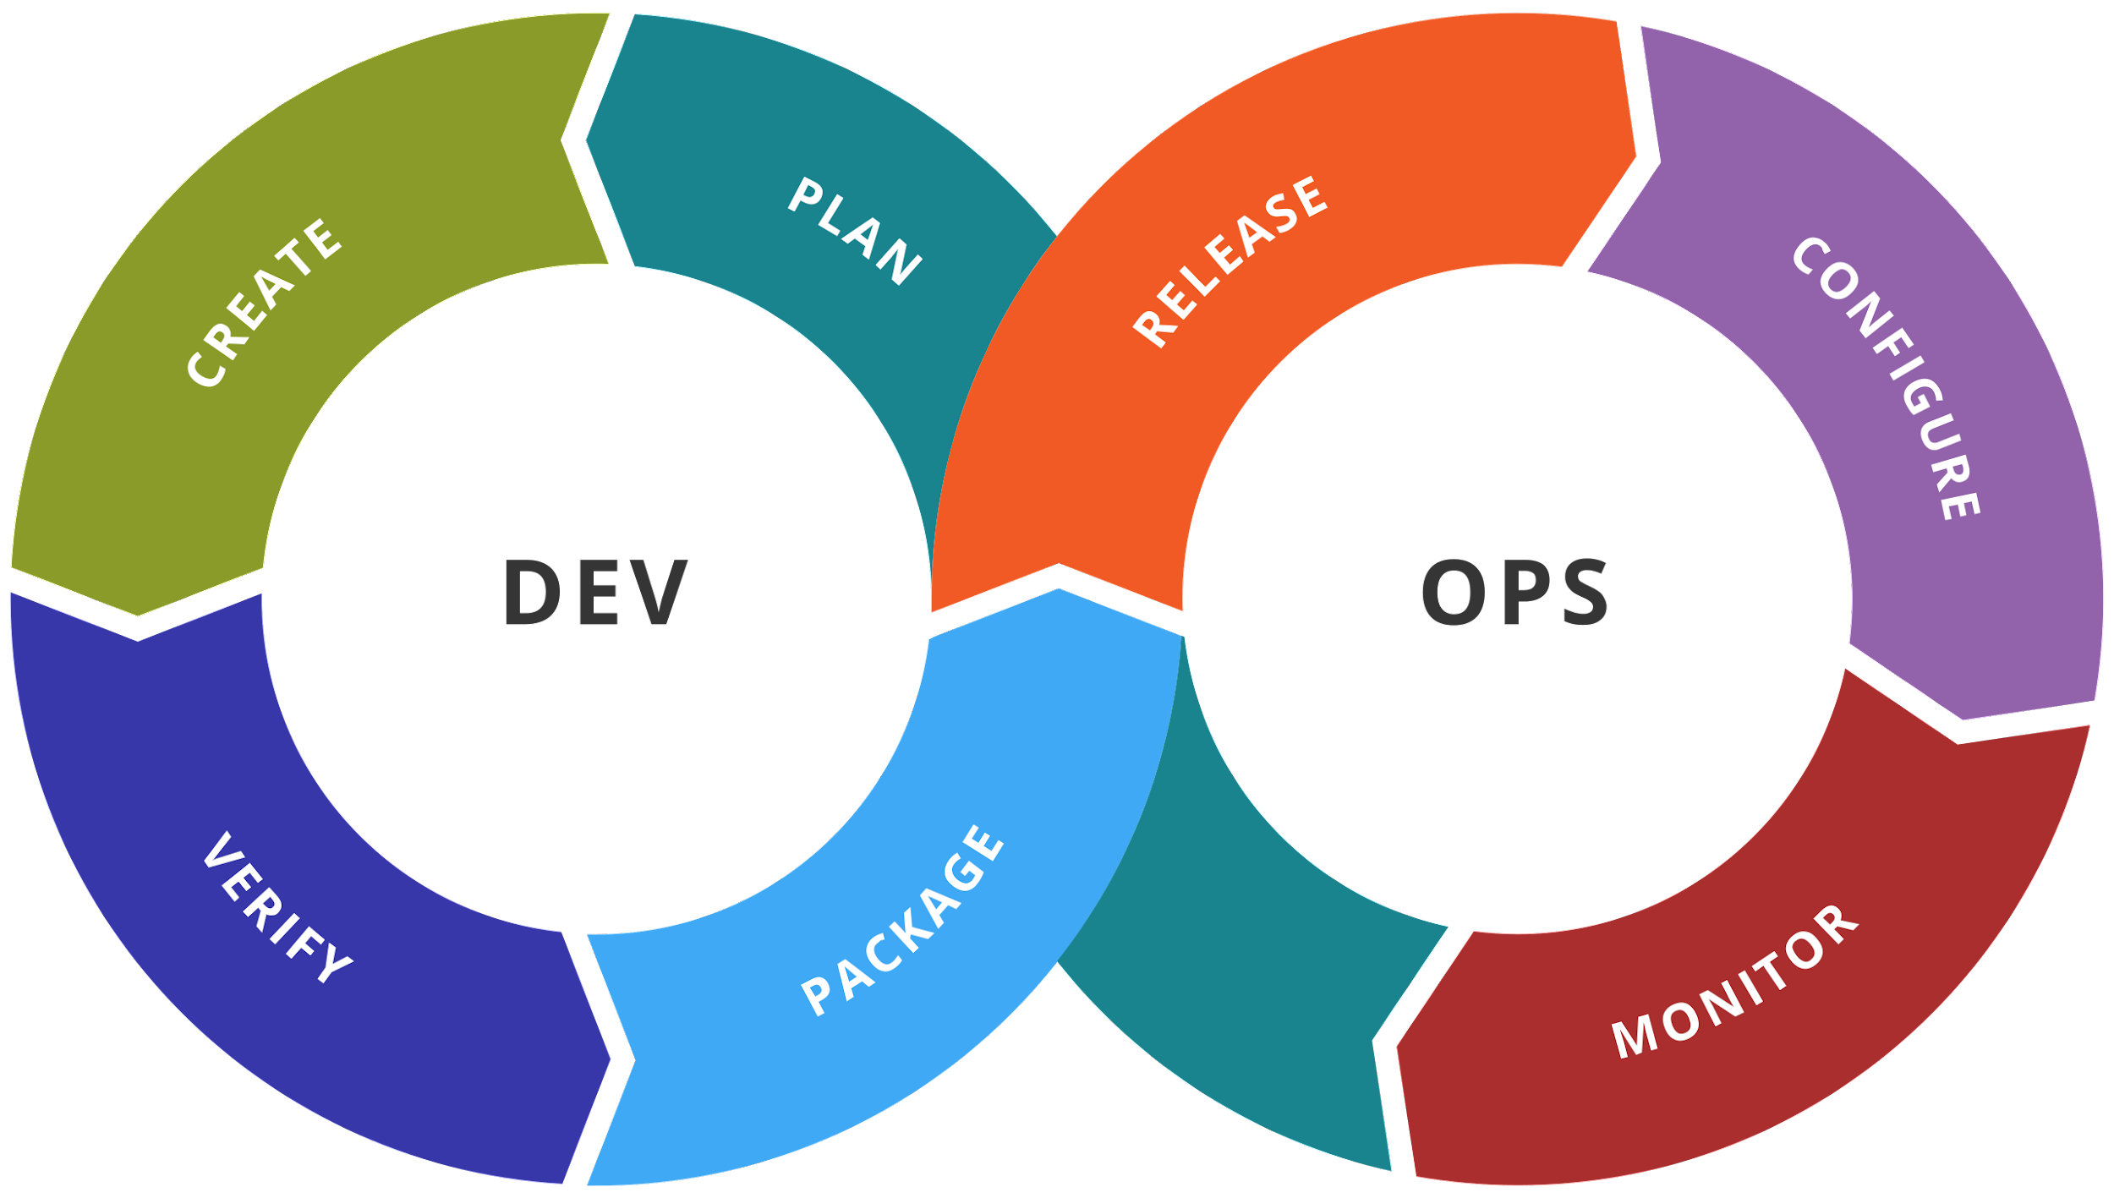

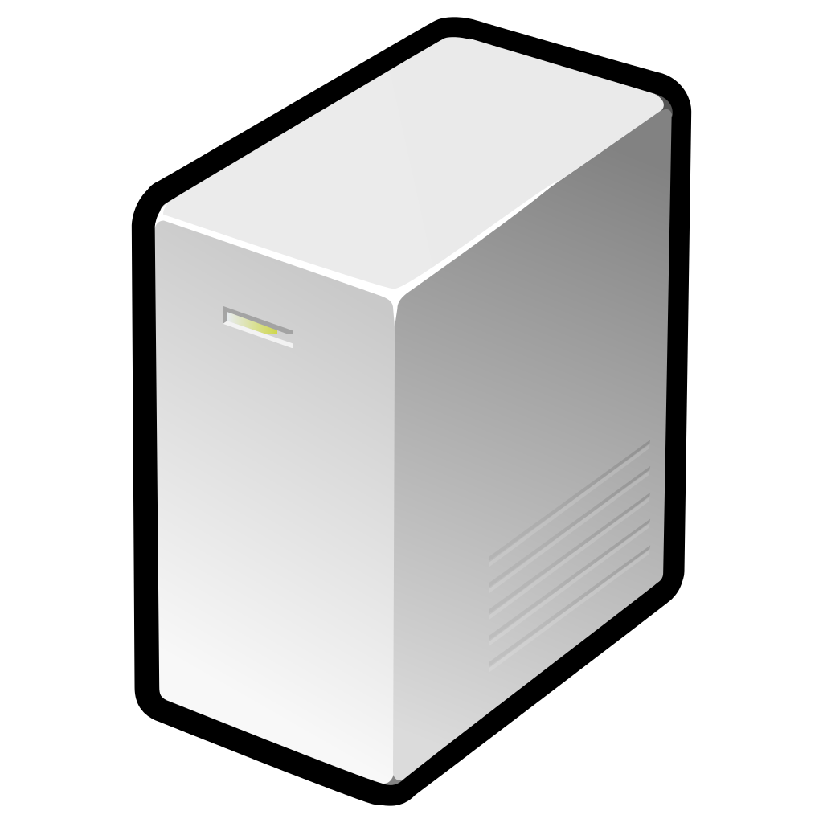

DEV + OPS
DEV TEAM :-
A “Dev Team” or Development Team consist of individuals responsible for core development of the project.
They are the one who write the code and develop various features of the project.
OPS TEAM :-
The “Ops team” or Operations team is responsible for the deployment and delivery of the project from the company to the client.
The task of software testing and maintenance may also come under the role of Ops Team.

Slide 6



Why DEVOPS?
GAP
Customer
Customer Requirements
Development
&
Testing
Operations
Team

Slide 7
What Gap?
Most deliveries of softwares features testing in development environment not the delivery environments.
Development systems may not be same as production systems.
Not much concern about the infrastructure as well as deployment impact because of code changes

Slide 8

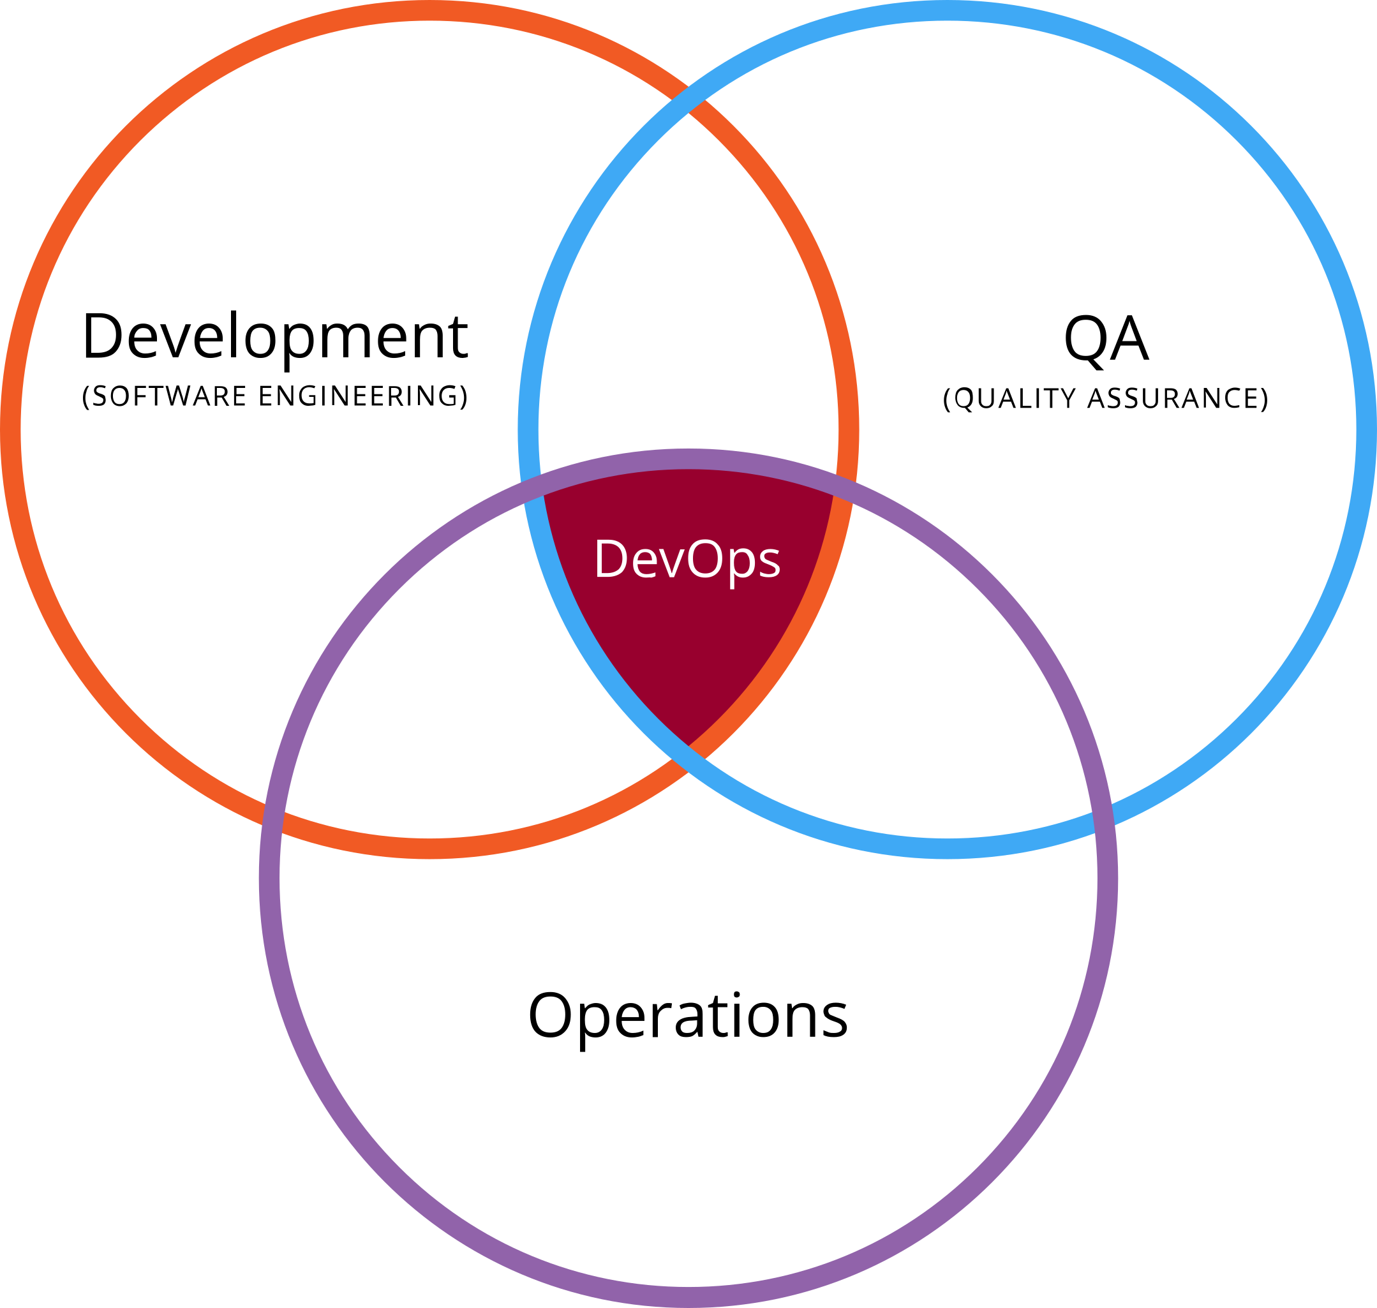
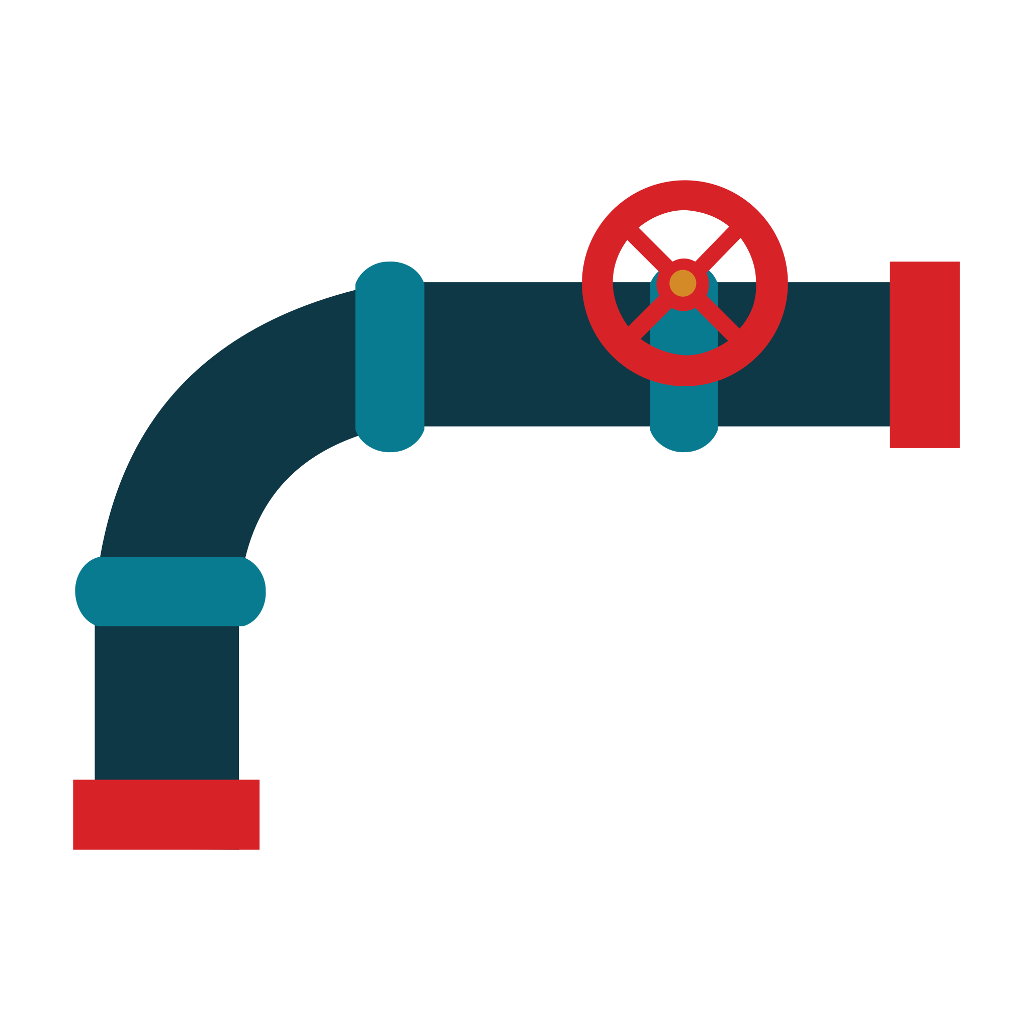


Devops Solution to the challenges
Developers work closely with the production equivalent systems.
Automated deployments with pipelines
Version control systems to keep track of the applications
Continuous Monitoring tools to monitor the performance and load balancing
Better Collaboration among individuals

Slide 9
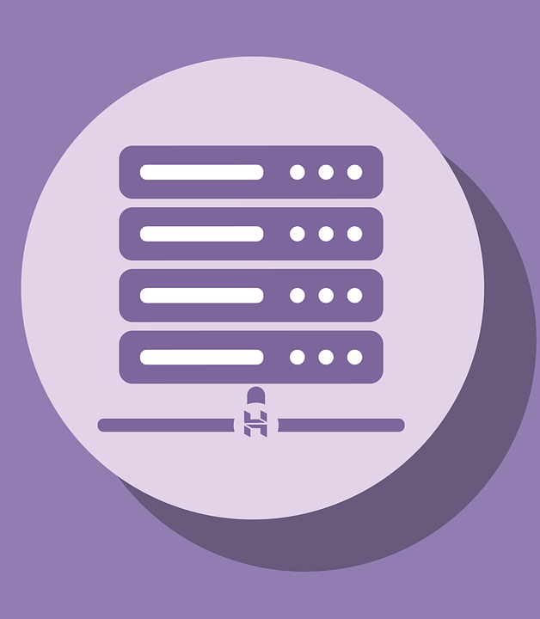
After DevOps
Continuous Integration
&
Continuous Deployment
Deployment Servers
Customer
Customer Requirements

Slide 10
DevOps Terminologies
Pipelines
Set of automated processes and tools.
Integration of tools to ensure the continuous Integration and Deployment.
Code analysis, testing and maintenance.
Continuous Integration
Continuous Deployment
Integrate code changes by each developer to keep main branch up to date.
Continuous deployment after each commit.
Automatic rollbacks if the deployment fails

Slide 11
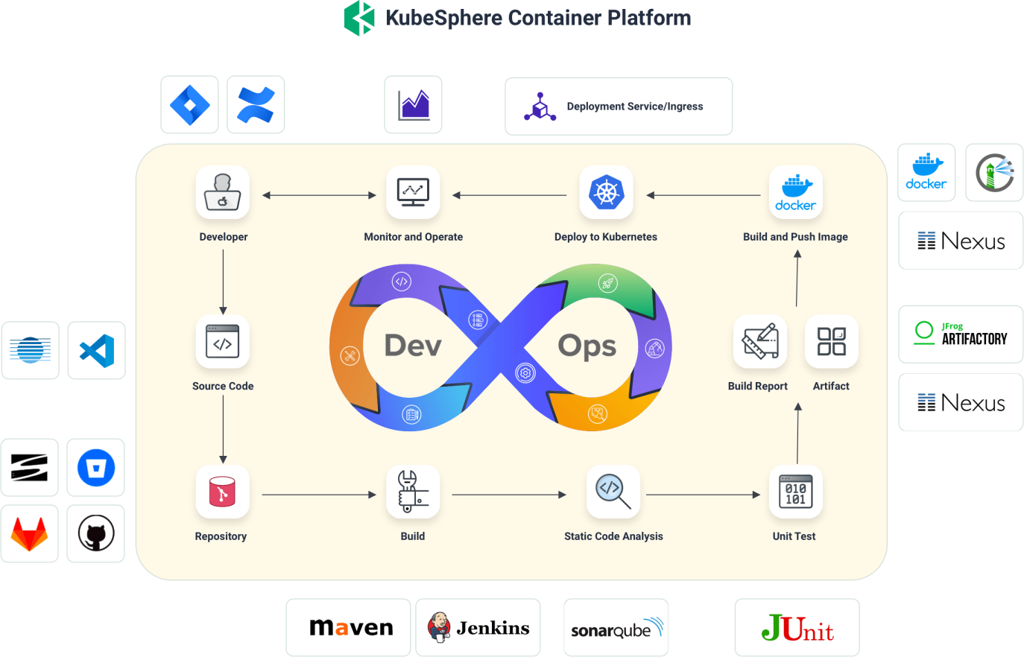
Tools for DevOps

Slide 12
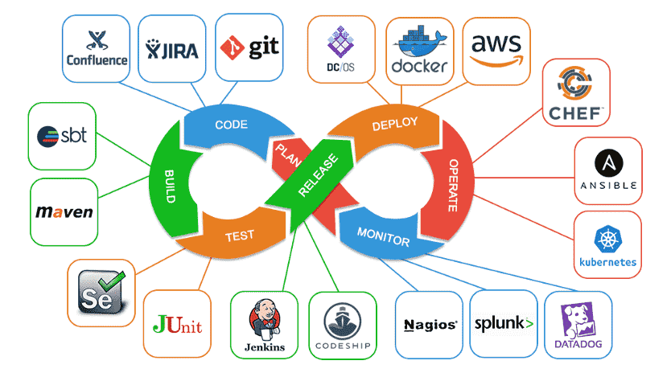
Tools for DevOps

Slide 13
Thank You

